Slide 1

►Feasibility study◄ (hospital)

Slide 2
1-PROJECT CONCEPT
-The project aims to conduct a detailed feasibility analysis to create a website for a private hospital online to provide services to help the patient and save him as soon as possible, whether online or offline, and also contribute to providing medicines to the patient and medical and surgical supplies that the hospital needs.

Slide 3
2-PROJECT JUSTIFICATION
The idea presented by the project is to build a private hospital online, based on a group of the most efficient doctors in a suitable and desirable place for the public. The project aims to help patients, whether online or offline, and provide the best medical machines and medical supplies for them, as well as medicines, especially medicines that are difficult to find and help the hospital to provide the best Surgical machines, medical supplies, and medicines that are not in the market by contracting with other pharmaceutical companies and private hospitals and trying to develop and improve the hospital. Among the services provided by the private hospital
-Providing alternatives to medicines that are not available in the market
-Multiple easy payment methods
- Ease of dealing with hospitals and pharmacies - ---save time and effort

Slide 4
3-Marketing
In our project, we rely entirely on (IT) technology It is very useful Special services are provided in this private hospital and there are many as the hospital is available throughout the day We can attract patients in various ways, including discounts and discounts And we built the hospital in an area devoid of hospitals, that brings patients The hospital publishes its numbers and services in several forms, and this helps the delegation to it greatly

Slide 5
4-Technical
The stage of implementing the system
-Internet Service Provider ISP
- routers
-hardware Implementation team
-Test team
Risk Phase
- We may have a burden in the hospital, an increase in the number, and the hospital's inability to provide service or receive patients

Slide 6
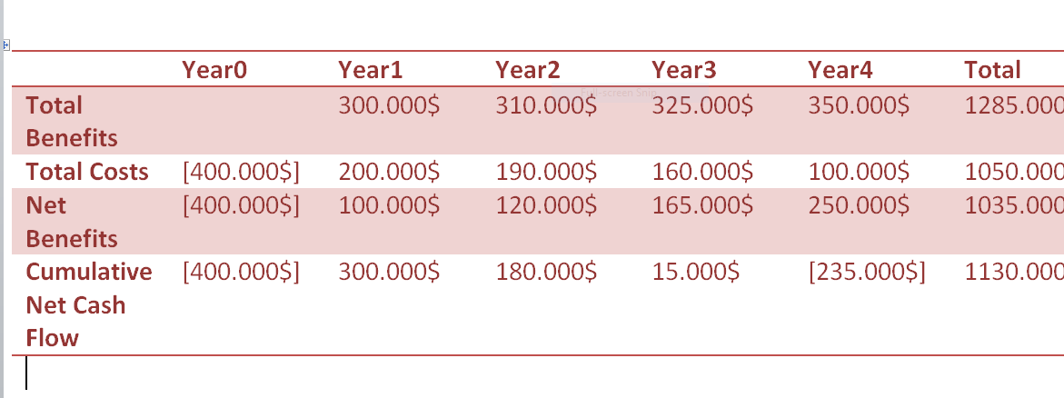
5- cash flow projection

Slide 7
-return on investment ( ROI)
ROI = ( Total benefits − Total costs) / Total costs .
ROI= (1285.000 − 1050.000) / 400.000 ROI =0.5875

Slide 8
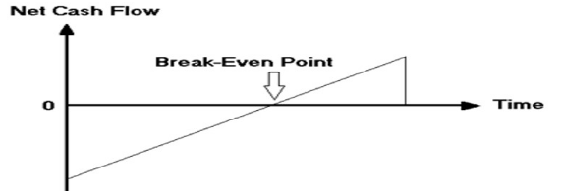
-Break –Even point ( BEP)
BEP = year negative +( year net cash − year coom ) / year coom BEP = 2 + ( 165,000 − 15,000 ) / 165,000 = 0.90

Slide 9
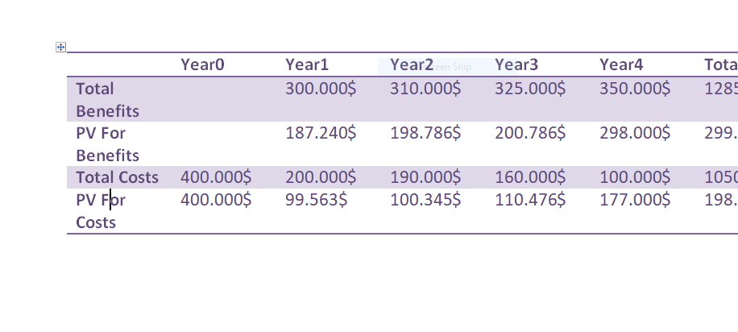
-discounted cash flow projection
calculated using a 15 % required rate of return

Slide 10
NET present value( NPV)
NPV = PV of total benefits − PV of total costs
NPV =299.754$ − 198.000$=101.754$

Slide 11
Organizational
This project has very few risks and its goal is to provide services and make them available in an easier and continuous manner.
-team:
-علياء امبارك قابيل
-فاطمة عبد الصمد عثمان
-فاطمة محمد عبد الدايم

